Slide 1

Understanding Employee Attrition
A deep dive into key factors influencing employee turnover.

Slide 2

Key Attrition Metrics
1470
16.1%
36.92
Overall Employees
Attrition Rate
Avg Age
6.50K
Avg Salary
7.01
1233
2.47
Avg Tenure
Active Employees
Avg Job Satisfaction (Attrited)
237
Total Attrition

Slide 3
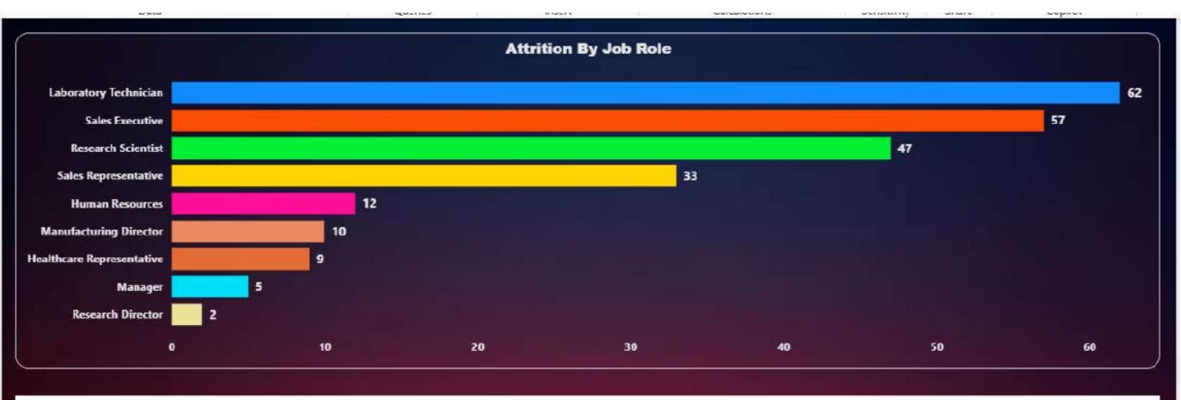
Attrition by Job Role
Laboratory Technicians and Sales Executives show the highest attrition, followed by Research Scientists and Sales Representatives. Managerial and senior research roles have significantly lower attrition.
Business Meaning:
Operational and customer-facing roles experience higher employee exits, while leadership and specialized senior roles are more stable.
Action:
HR should focus retention strategies on Laboratory Technicians and Sales roles by improving career growth paths, workload balance, and incentive structures.

Slide 4
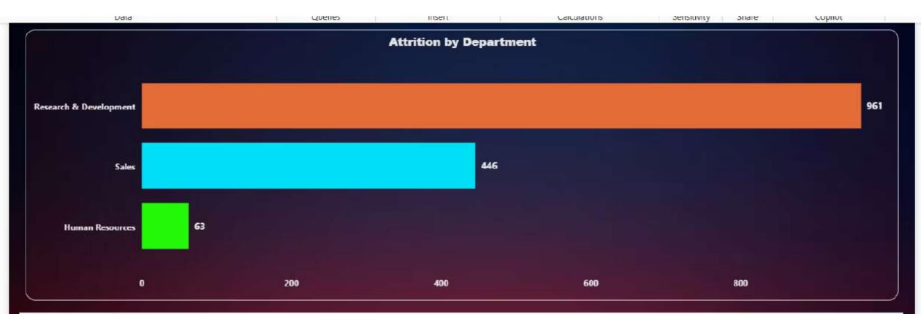
Attrition by Department
The Research & Development department contributes the largest share of attrition, followed by Sales. Human Resources shows minimal attrition.
Business Meaning:
High attrition in R&D and Sales indicates pressure-heavy roles and competitive job markets, whereas HR roles are relatively stable.
Action:
HR leadership should prioritize R&D and Sales for retention programs, such as skill development, role rotation, and performance-based rewards.

Slide 5
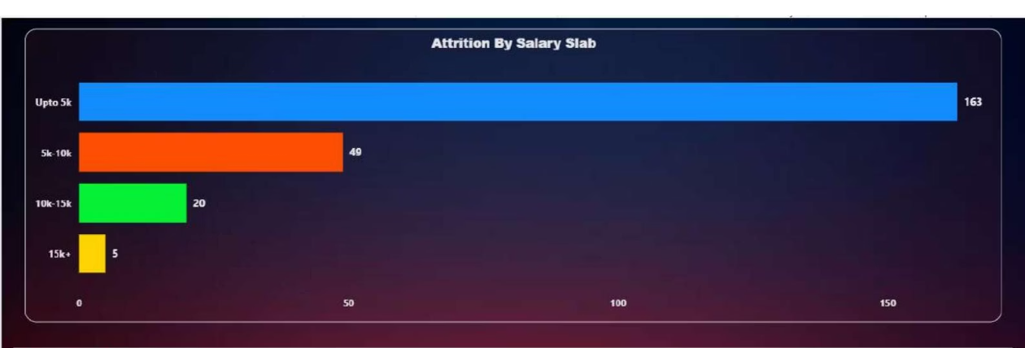
Salary's Impact on Attrition
Employees earning up to $5K salary contribute the highest attrition. Attrition decreases sharply as salary increases, with minimal exits in the highest salary slab.
Business Meaning:
Compensation is a strong driver of attrition, particularly for lower-paid employees.
Action:
Revisiting salary structures, especially for entry-level and low-income roles, can significantly reduce attrition.

Slide 6
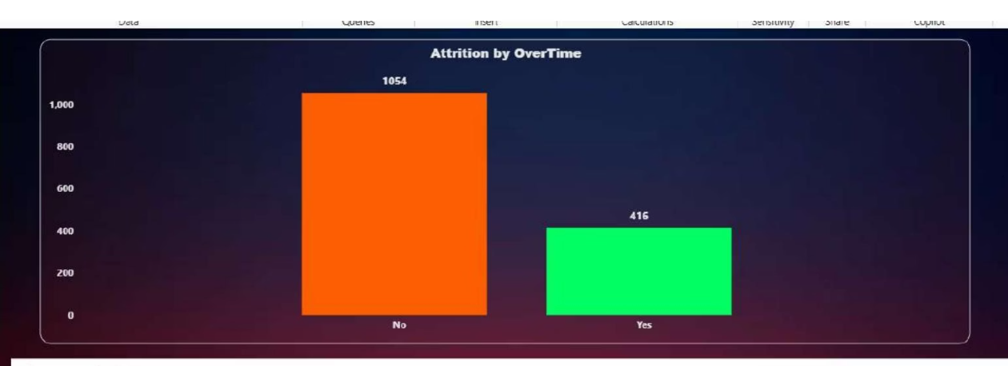
Overtime and Attrition
Employees working overtime show a noticeably higher attrition count compared to those without overtime.
Business Meaning:
Extended working hours and work pressure directly impact employee retention.
Action:
HR should monitor overtime patterns and introduce workload balancing, flexible schedules, or additional compensation for overtime employees.

Slide 7
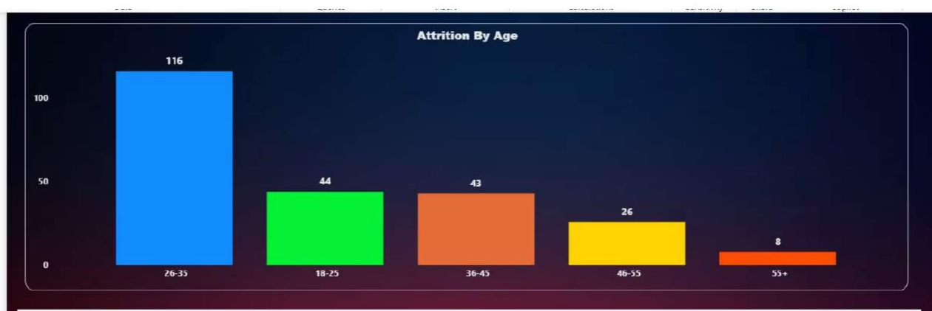
Age Group and Attrition
The 26–35 age group shows the highest attrition, followed by employees aged 18–25 and 36–45. Attrition is lowest among employees aged 55+.
Business Meaning:
Early-career and mid-career professionals are more likely to switch jobs for better growth, compensation, or opportunities.
Action:
Career progression plans, learning programs, and leadership tracks should be strengthened for employees aged 26-35.

Slide 8
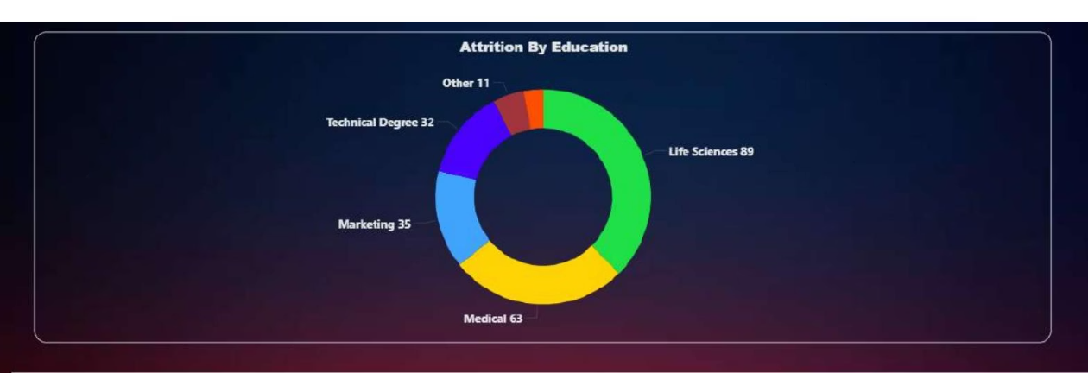
Education Background and Attrition
Employees from Life Sciences and Medical education backgrounds contribute the highest attrition, followed by Marketing and Technical degrees.
Business Meaning:
Certain education fields face higher market demand, increasing job-switching behavior.
Action:
Retention efforts should include competitive compensation, domain-specific career growth, and long-term engagement plans for high-demand skill groups.

Slide 9
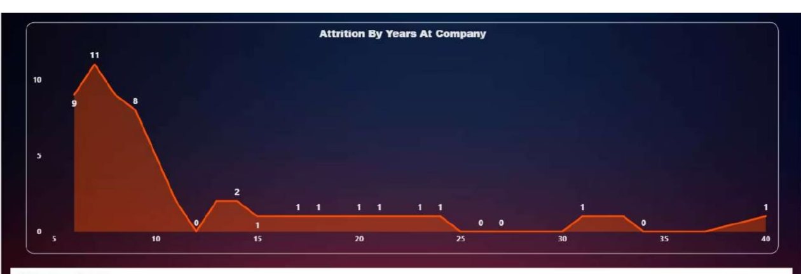
Tenure and Attrition
Attrition is highest during the early years of employment and declines significantly as tenure increases. Long-tenured employees show very low attrition.
Business Meaning:
Employee exits are most common during the initial years, indicating onboarding and early engagement challenges.
Action:
Improving onboarding experience, mentorship programs, and early performance feedback can reduce early-stage attrition.

Slide 10

Strategic Retention Initiatives
Enhanced Onboarding
Implement robust mentorship and feedback programs for new hires.
Career Development
Offer clear growth paths and skill development for key roles.
Compensation Review
Adjust salary structures, especially for entry-level and high-demand roles.
Work-Life Balance
Monitor overtime and introduce flexible schedules to reduce pressure.

Slide 11
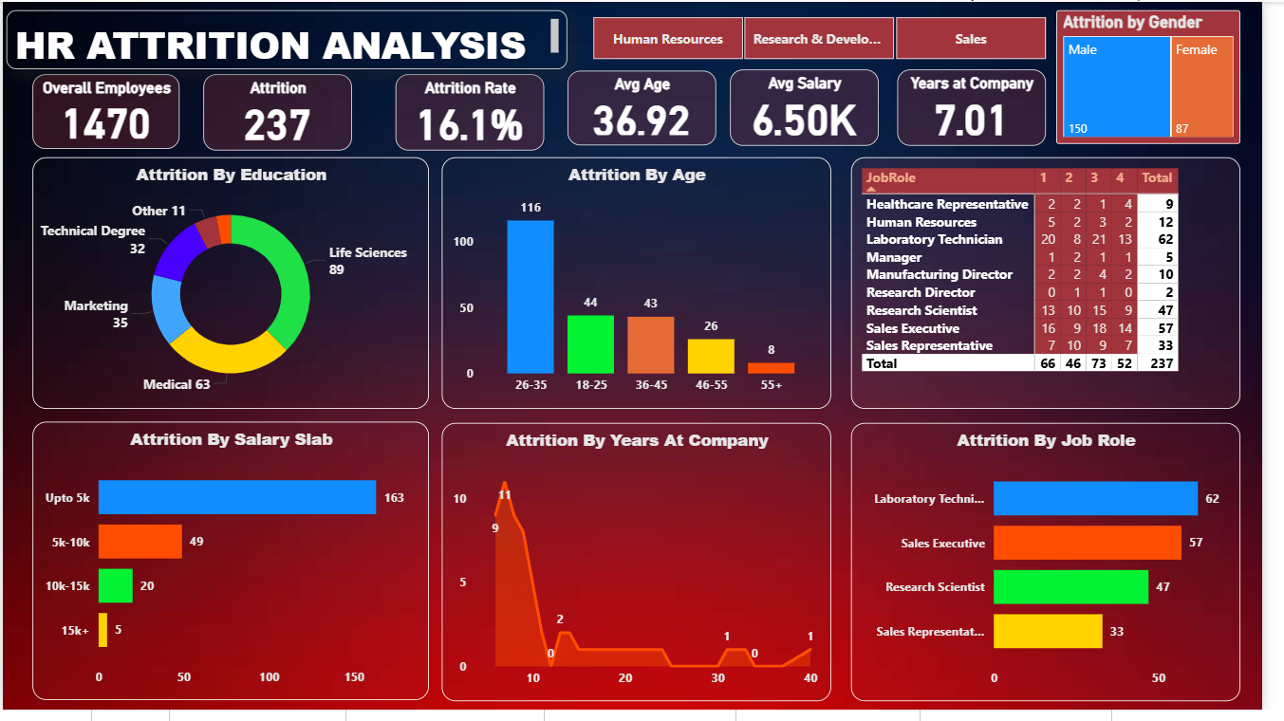

Slide 12
CONCLUSION
The HR Attrition Analysis dashboard provides a comprehensive, data-driven view of employee turnover across departments, job roles, compensation levels, demographics, and tenure.
The analysis reveals that attrition is primarily driven by lower compensation, overtime workload, early tenure challenges, and high-demand job roles. Employees in operational and customer-facing roles, particularly within R&D and Sales, show the highest risk of attrition.
By leveraging these insights, HR leadership can proactively identify high-risk employee segments and implement targeted retention strategies such as compensation restructuring, workload management, and career development programs.
Overall, this Power BI solution enables informed decision-making, supports workforce planning, and helps reduce attrition-related costs while improving employee satisfaction and organizational stability.

Slide 13
RECOMMENDATIONS
🔹 1. Focus Retention Efforts on High-Attrition Job Roles
HR should prioritize retention programs for these roles by introducing clearer career progression paths, role-based incentives, and skill development opportunities.
🔹 2. Address Attrition in Research & Development and Sales Departments
Introduce department-specific engagement strategies such as workload optimization, recognition programs, and periodic role rotation to reduce burnout and job fatigue.
🔹3. Improve Compensation Structure for Lower Salary Slabs
Re-evaluate entry-level salary bands and introduce performance-linked pay or retention bonuses to improve employee satisfaction and reduce early exits.
🔹 4. Reduce OverTime-Related Attrition
Implement better workload distribution, flexible working hours, and overtime compensation policies to minimize employee burnout.
🔹 5. Strengthen Engagement for Early and Mid-Career Employees
Introduce mentorship programs, fast-track career growth plans, and continuous learning opportunities to retain high-potential employees.
🔹 6. Enhance Onboarding and Early Tenure Experience
Improve onboarding processes, provide early performance feedback, and assign mentors during the initial employment phase to improve employee retention.
🔹 7. Target High-Demand Education Groups with Specialized Retention Plans
Develop specialized career tracks, competitive compensation, and long-term engagement initiatives for employees with high-demand skill sets.

